Slide 1

What Data Science Skills Are Most Valued?
Jennifer Abinette
Avery Davidowitz

Slide 2

Approach
Analyze Job Listings for Data Scientist positions
Most Frequently Referenced = Most Valued
Skills per job listing
Affect of job location

Slide 3



Data Sources
U.S. Population by City
dataset retrieved from census.gov
U.S. State Abbreviations
dataset retrieved from usps.gov
U.S. Data Scientist Job Listings
6,953 data scientist job listings scraped from Indeed.com and posted for use on Kaggle.com
List of Data Science Skills
dataset created based on 1st page of Google Search results of Data Scientist Skills
Github Repository: https://github.com/JAbinette/CUNY-607-Project-3-Data-Science-Skills

Slide 4
Methodology
Load datasets from Github Repository into R
Tidy/Transform in R
Load into Google Cloud MySQL Database
Conduct analyses in R

Slide 5
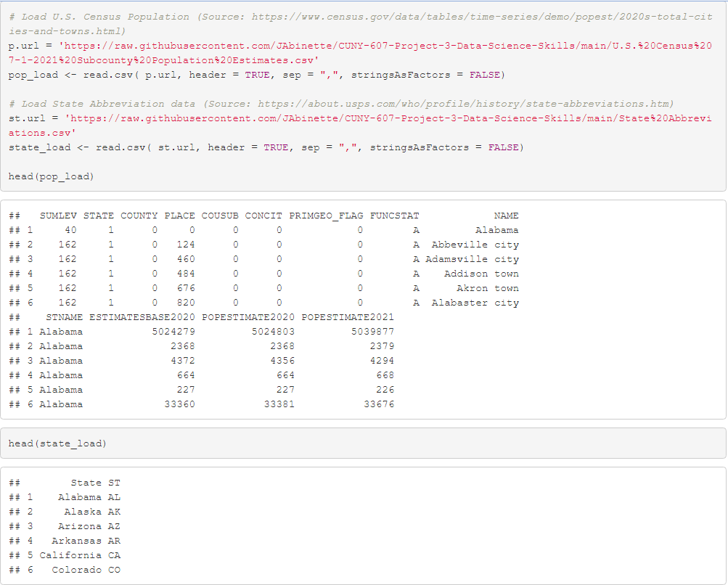
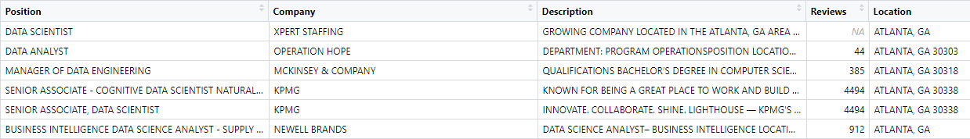
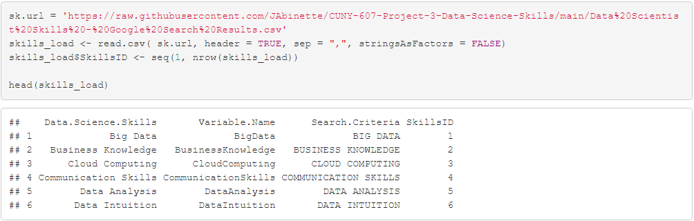
Load Datasets from Github
Github Repository: https://github.com/JAbinette/CUNY-607-Project-3-Data-Science-Skills
read.csv

Slide 6
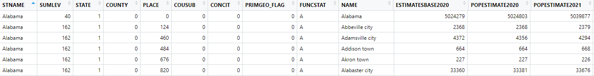


Tidy Transform
U.S. Census Population Dataset
Location Table

Slide 7
U.S. Census Population Dataset
Key Things to Address:
Remove aggregates
Prepare data to join with Job Listings

Slide 8
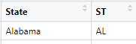
U.S. Census Population Dataset
State Abbreviations Dataset
merge

Slide 9

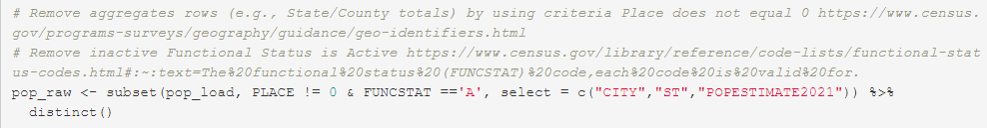

Isolate City
Subset Data
Assign ID Number
str_to_upper
word
subset
seq
nrow

Slide 10
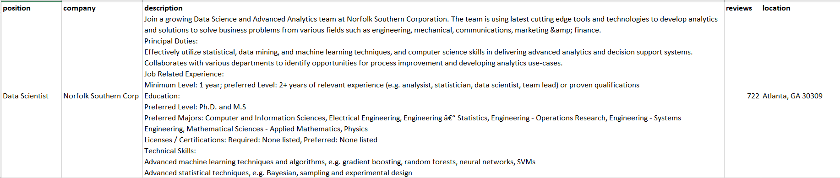

Tidy/Transform
U.S. Job Listings
Key Things to Address:
Refine listings to only Data Science/Scientist
Prepare data to join with Location table
Job Table

Slide 11
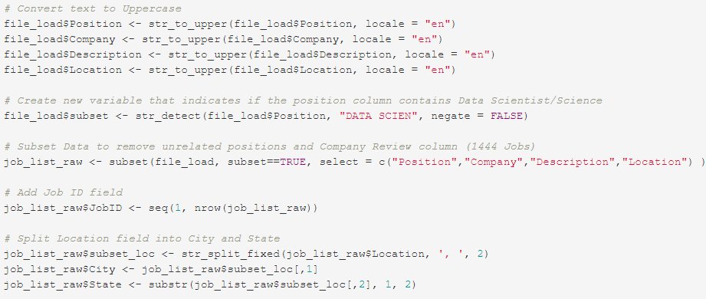
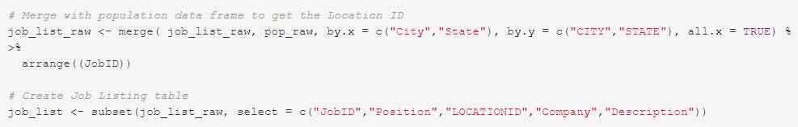
str_to_upper
str_detect
subset
seq
nrow
str_split_fixed
merge

Slide 12
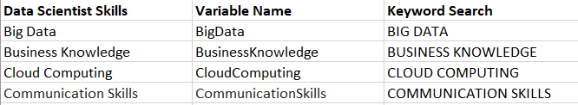
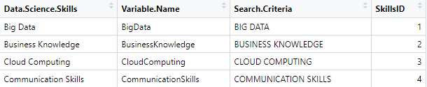
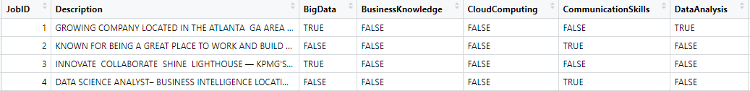
Tidy Transform
Job Listings
Skills List
Skills Table
Job Skills Table

Slide 13
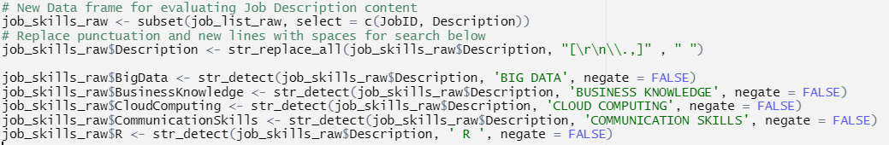
subset str_replace_all
str_detect

Slide 14


Load into Google Cloud

Slide 15
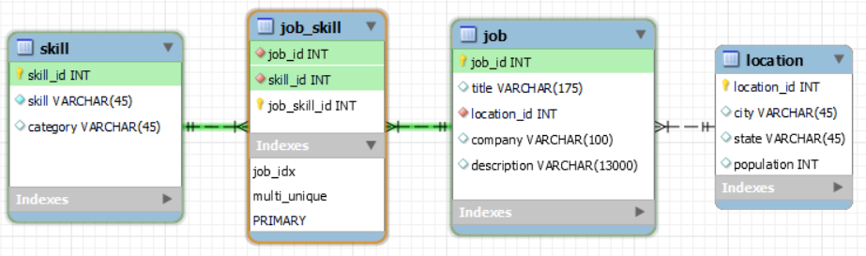
Database Model
MySQL Workbench
Schema
ER Diagram
Export SQL Create Script

Slide 16
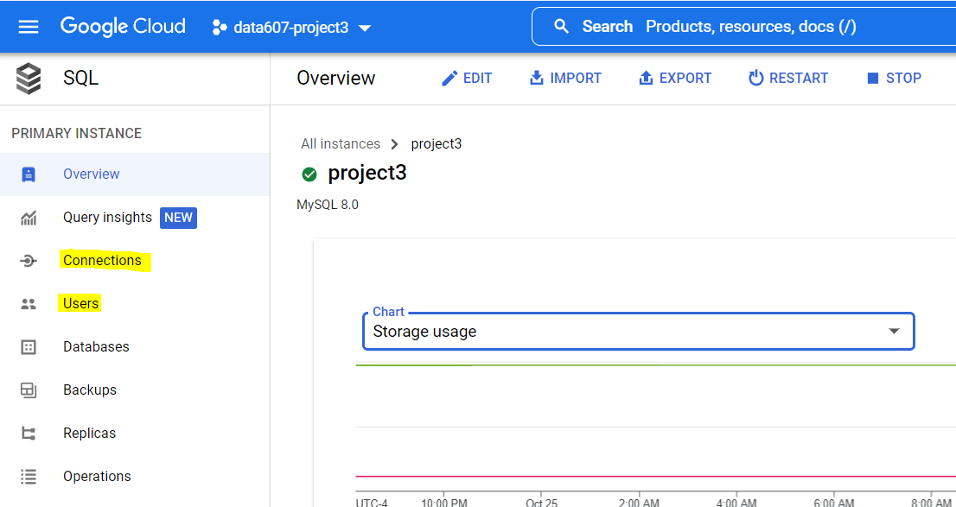
Google Cloud MySQL Instance
Connections
Users

Slide 17
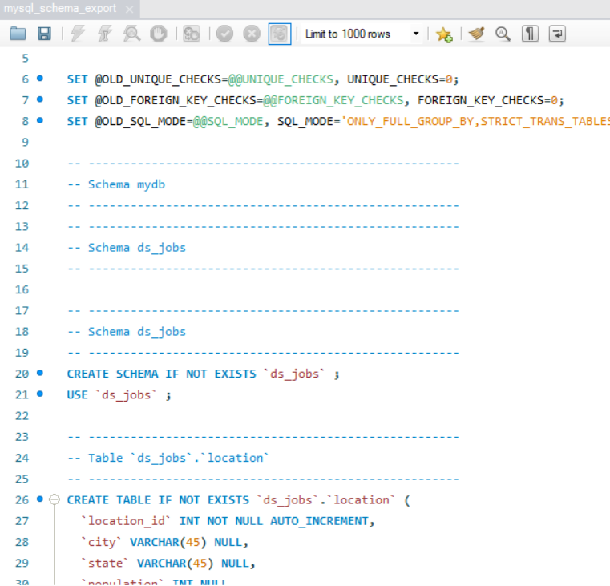
Create Script

Slide 18
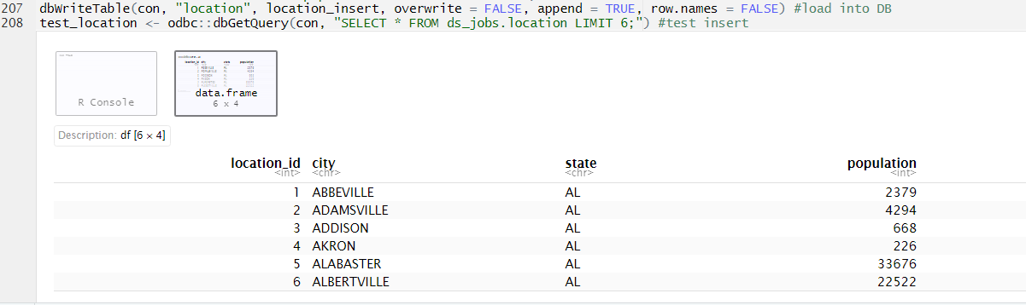
Load Dataframes to Database
dbWriteTable
dbGetQuery

Slide 19
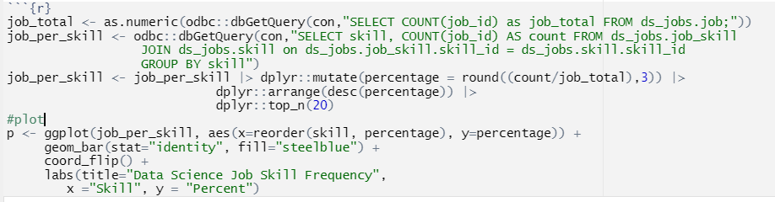
Analysis
Query from Database
as.numeric
dbGetQuery
Create
Top 20
mutate
arrange
top_n
Plot with ggplot
ggplot
geom_bar

Slide 20
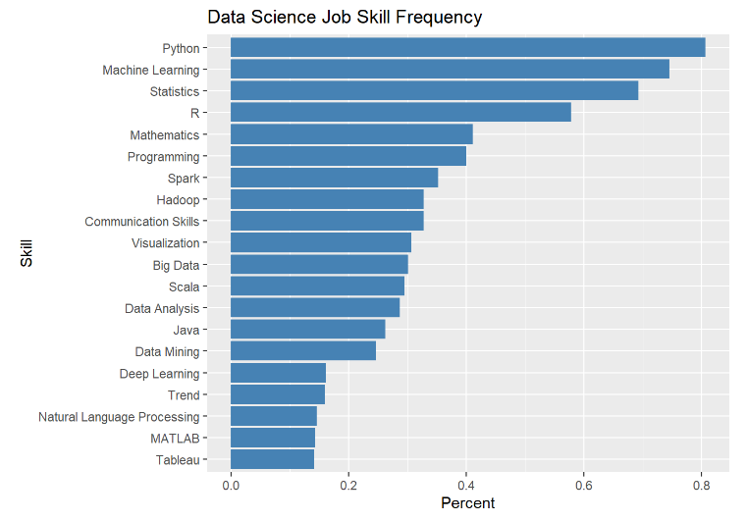
What are the Top 20 Job Skills?

Slide 21
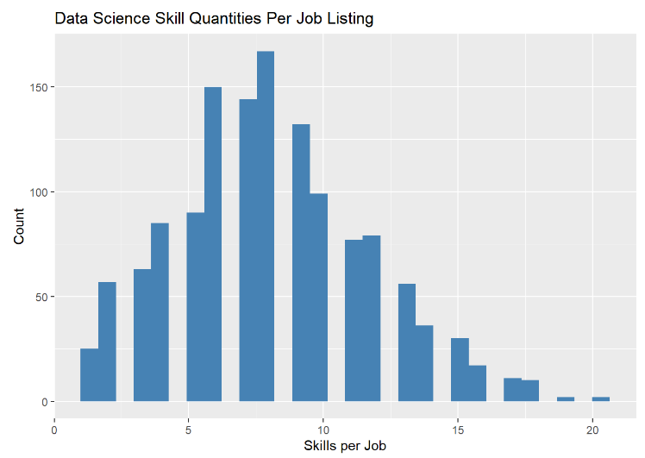
How many skills are included per job listing?

Slide 22
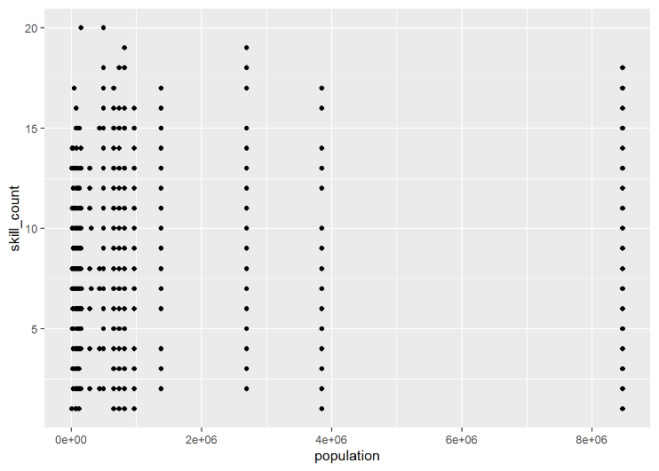
Does the number of skills per job vary by population of the job location?

